Slide 1
Standardised PPT on GST
Indirect Taxes Committee
The Institute of Chartered Accountants of India

Slide 2
Disclaimer and Copy right
This presentation has been prepared to provide a standard ‘user presentation’. The views expressed in this presentation are those of Speaker(s). The Institute of Chartered Accountants of India may not necessarily subscribe to the views expressed by the speaker(s).
The information cited in this presentation has been drawn from various sources. While every efforts have been made to keep the information cited in this presentation error free, the Institute or any office do not take the responsibility for any typographical or clerical error which may have crept in while compiling the information provided in this presentation. Further, the information provided in this presentation are subject to the provisions contained under different acts and members are advised to refer to those relevant provision also. For clarifications write to us at idtc@icai.in
© The Institute of Chartered Accountants of India
This standardised PPT may be used by any person with due acknowledgement to the Indirect Taxes Committee of ICAI.

Slide 3
E-Way Bill under GST

Slide 4

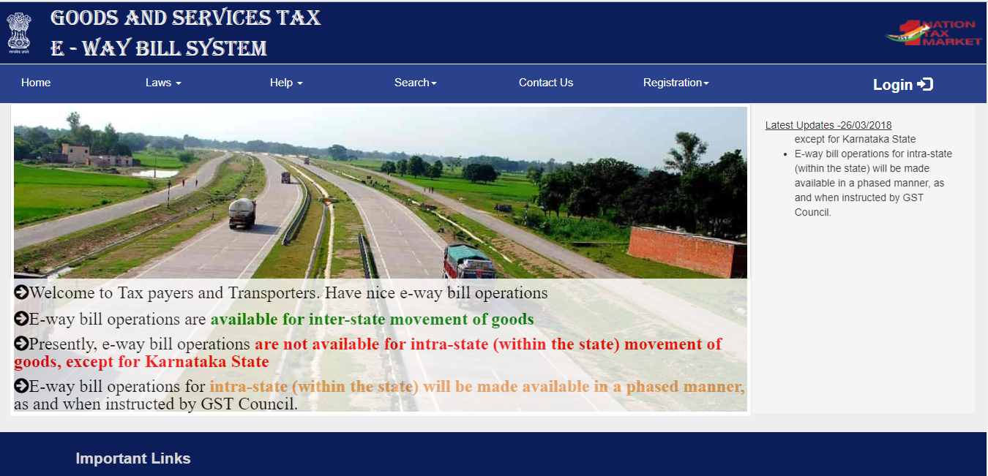
E – Way Bill http://ewaybill.nic.in

Slide 5
Agenda
Registration
e-Way Bill
  Generation
    Manual
    Json
  Modification / Updation
  Rejection
  Cancellation
  User Management
  Reports
SMS - Services
  Generate
  Cancel
  Update
Best Practices
  API Interface
Ver 1.2
Get Latest Version

Slide 6
Who can Register and use e-way bill Portal
Who can Register
Registered Dealer
Citizen / Unregistered Dealer
Transporter
Registered under GST
Unregistered

Slide 7
Registration: Regular Dealer

Slide 8
Process
eWay Bill Portal
eWay Bill Registration
Enter GSTIN
Set User Name & Password
Confirm OTP
Registration

Slide 9
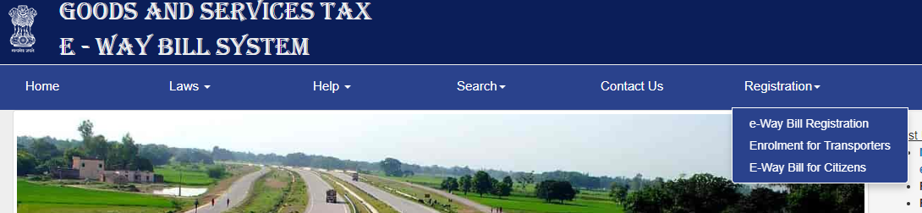
Step 1: Login – Registration www.ewaybill.nic.in

Slide 10
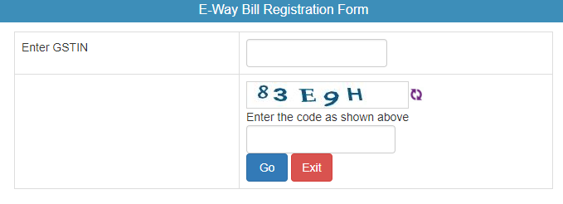
Step 2:
Enter the GSTIN Number and Click on “Go” to submit the request

Slide 11
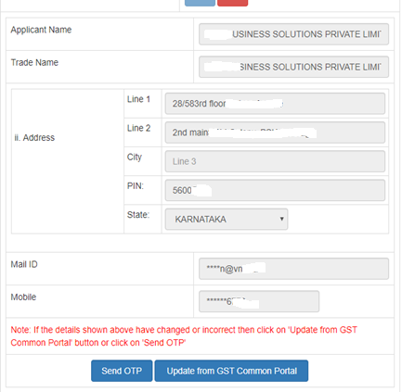
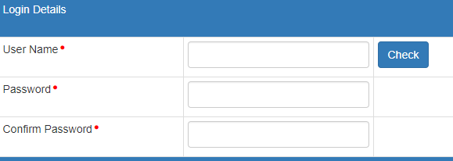
Step 3: Validate & Update Details
Step 4: Click on Send OTP & Verify OTP
Step 5: Set User Name & Password user choice

Slide 12
Registration:
Registered Transporters

Slide 13

Process
Regular Registration
Update
As Transporter
Login

Slide 14
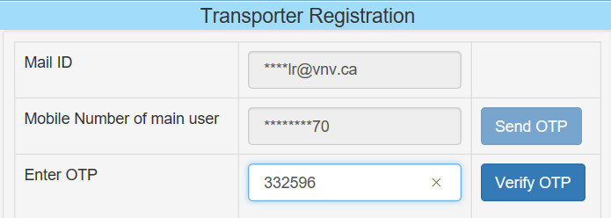
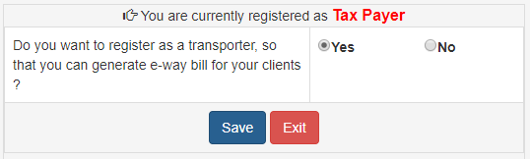
Transporter Registration

Slide 15
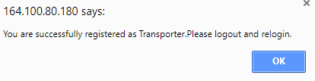
Confirmation

Slide 16
Registration: Unregistered Transporters

Slide 17
Process
eWay Bill Portal
Enrollment for transporters
Enter PAN and Validate
Set User Name & Password
Confirm OTP
15 Digit TRAN ID generated
Update Details
Registration

Slide 18
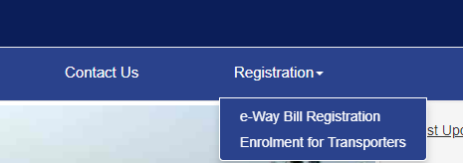
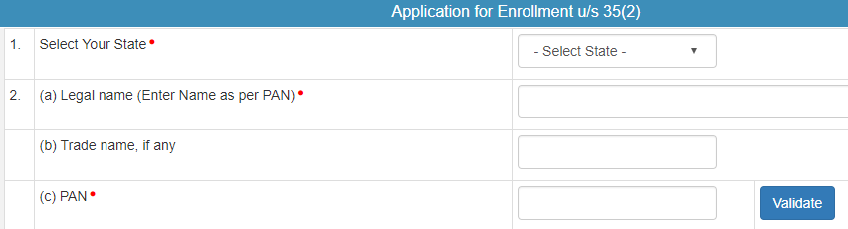
Registration- Unregistered Transporters
Step 1: Open the e-way bill portal and select “Enrolment of Transporters”
Step 2: Enter the details as required.
The user has to select the State and enter his legal name as given in his PAN and PAN number. The system user gets it validated by on click of ‘Validate’ button.
Notes:
Every owner or operator of warehouse or godown or any other place used for storage of goods and every transporter, irrespective of whether he is a registered person or not, shall maintain records of the consigner, consignee and other relevant details of the goods in such manner as may be prescribed.

Slide 19
Registration- Unregistered Transporters
Step 3: Update Registration Details
Select Enrolment Type
Warehouse/Depot
Godown
Cold Storage
Transport services
Principal Place of Business
Address Details
Update Aadhar + OTP
Proprietor
Main person of Company / Firm
Contact Information
email address and
mobile number
Upload Documents
Address Proof
ID Proof

Slide 20
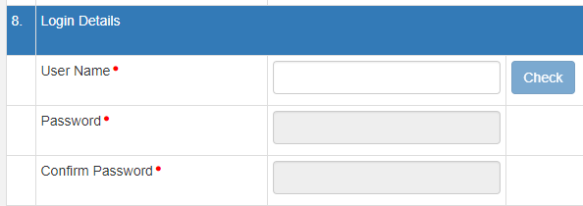
Registration- Unregistered Transporters
Step 4: Set Login Details
Step 5: Click on Submit. A 15digits TRAN ID would be generated
Eg : 29 AAAPG111M 1Z K ; same like a GSTIN <state code><PAN><1Z><check digit>

Slide 21
Operating e-way bill Portal

Slide 22
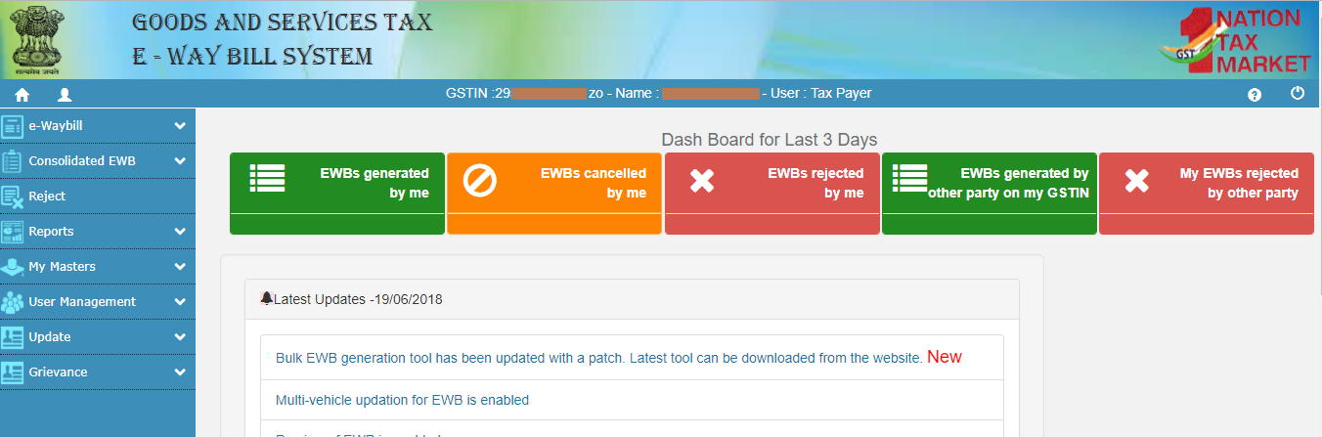
Dashboard
The details of EWBs relating to the user for the previous 3 days would be displayed

Slide 23
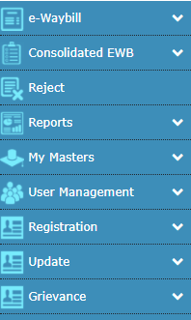
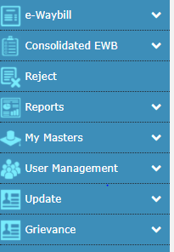
Login Options
Master User
Regular User

Slide 24
Main Menu
E-way Bill
Generate
Consolidated E-way Bill
Reject
Reports
Update
Cancel
Print
Generate
Re-generate
Print
My reports
To Reject E- Way Bill generated by others
Extend
Other reports
Master reports
Summary reports
Change to Multiple Vehicle
Update
Grievance
As Transporter
My GSTIN from CP
Detention Report
User Management
Change Password
Masters
Products
Clients
Supplier
Transporters
Bulk Upload

Slide 25
e-way Bill Generation

Slide 26
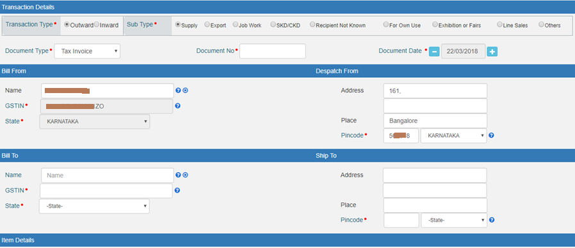
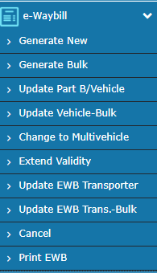
Options under e-way Bill
A. Generating a new e-way bill

Slide 27
Step 1: Transaction Type
Outward
Causing outwards movement of goods for supply or other than supply
Inward
Causing inward movement of goods for supply or other than supply

Slide 28
Step 2: Select Sub Type
Outward
Inward
Supply
Export
Job Work
SKD/CKD
Recipient Not Known
For Own Use
Exhibition or Fairs
Line Sales
Others
Supply
Import
SKD/CKD
Job work Returns
Sales Return
Exhibition or Fairs
For Own Use
Others

Slide 29
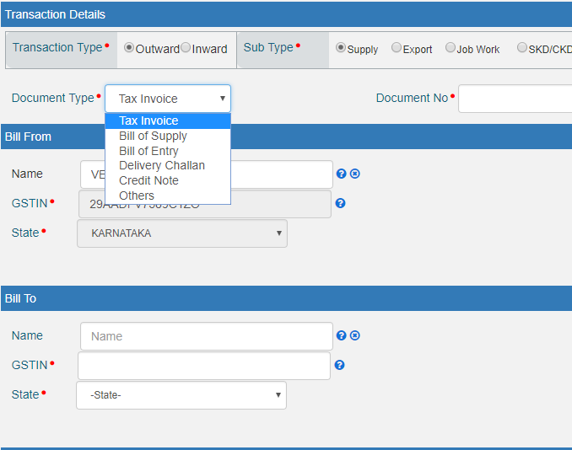
Step 3: Select the Document type
Tax Invoice
Bill of supply
Bill of entry
Challan
Credit note
Others

Slide 30
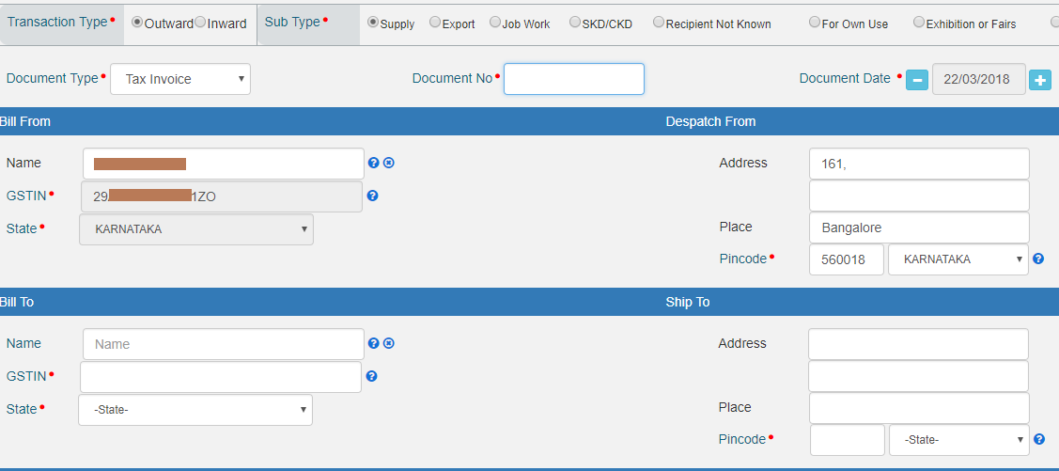
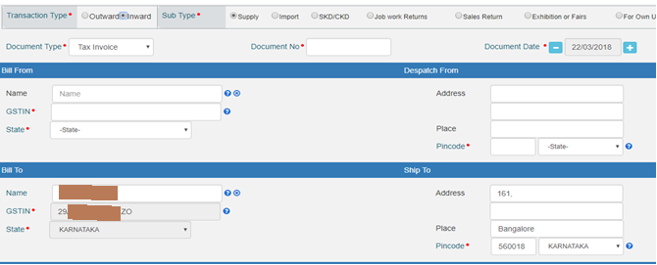
Ooutward
Step 4:Update Address
Outward
Outward
Bill FROM address-auto-populated
Bill TO address-To be entered
Inward
Bill FROM address-To be entered
Bill TO address auto-populated
Inward
Inward
Ship To and Dispatch From address can be altered

Slide 31
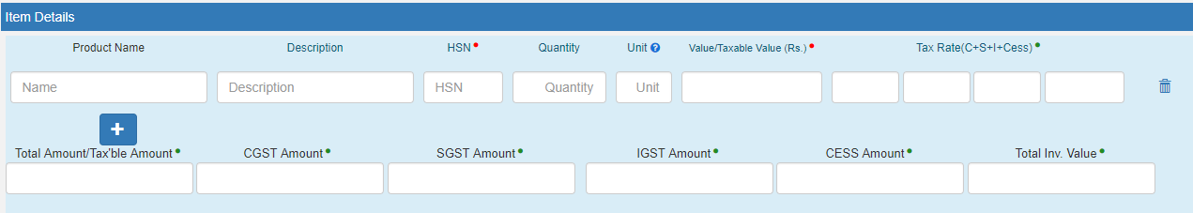
Step 5: Update Item Details
Item details
Product Name
Qty
Description
HSN
Units
Taxable Value
Tax Rate
Tax Amount
Taxable Value
Tax Amount
Consignment Value

Slide 32
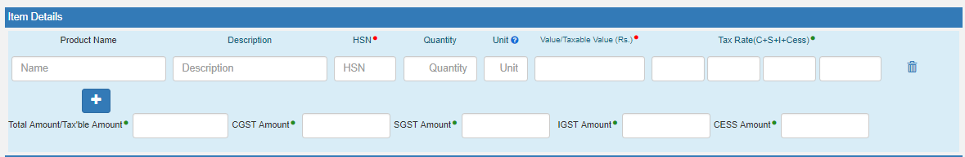
To add item details
Click on

Slide 33
Transportation : Mode + Details to furnish
Road
Transporter Name + Transporter Id (OR)
Vehicle Number
Rail
RR Number
Air
Airway Bill Number
Ship
Bill of Lading Number
Transporter Document no. & date
Transporter Name + Transporter Id
Approximate Distance
(in KM)
Between Consignor and Consignee

Slide 34
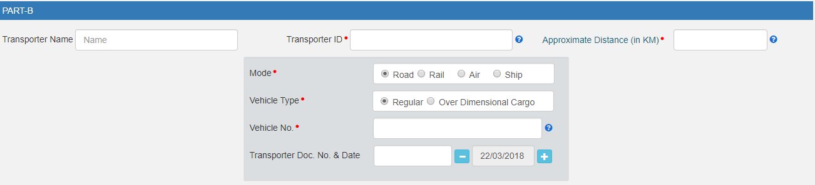
On Screen View

Slide 35
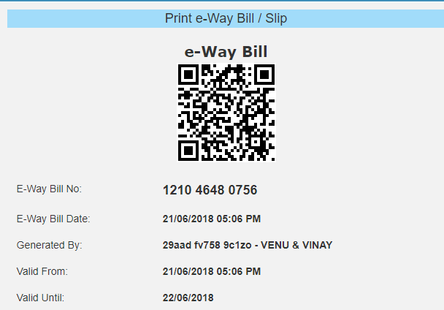
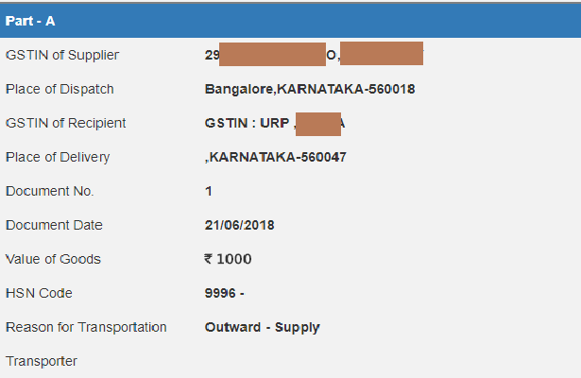
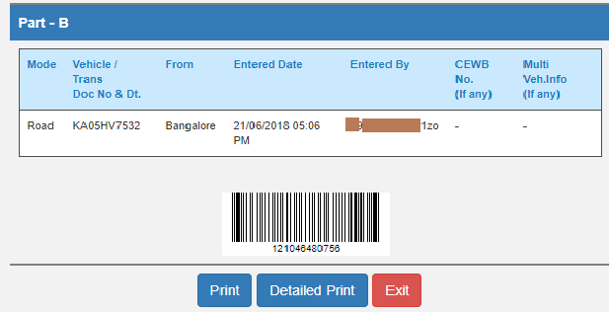
Submission and generation

Slide 36
Consolidate of Multiple eWay Bills

Slide 37
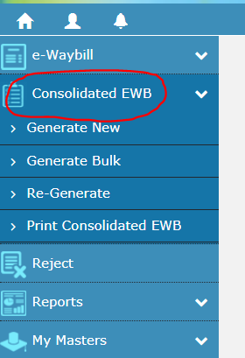
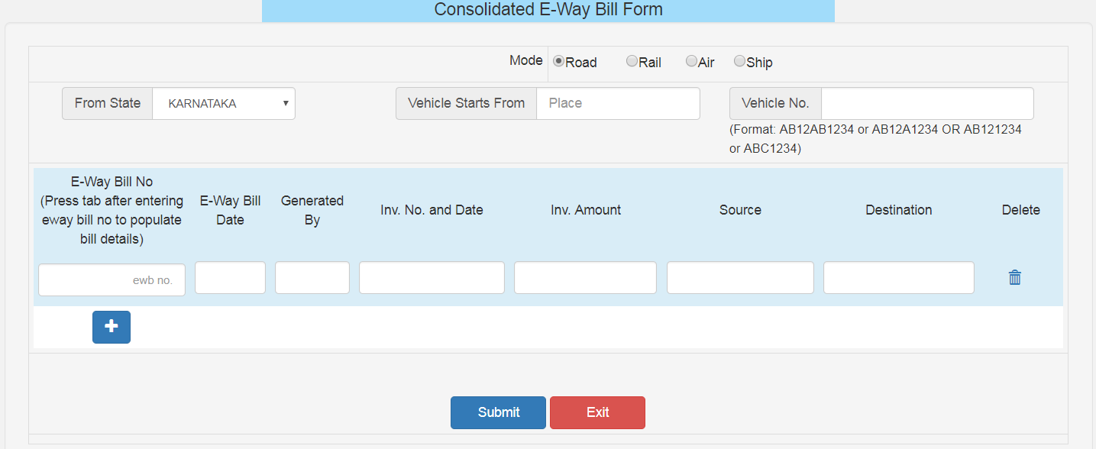
To generate consolidated e-way bill

Slide 38
Multiple Vehicle Update

Slide 39
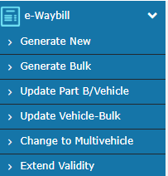
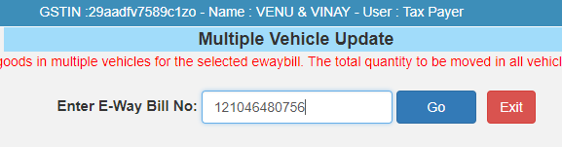
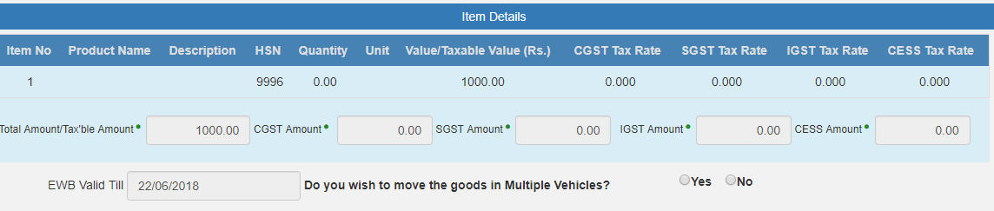
To move goods in multiple vehicles
Note: The Total quantity to be moved in all vehicles cannot exceed the quantity mentioned in this form

Slide 40
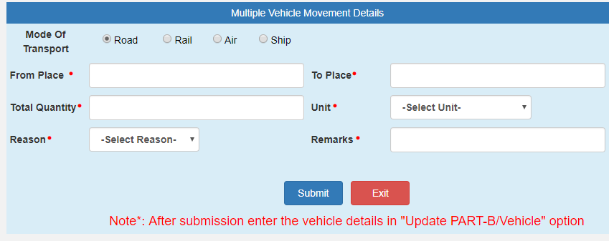
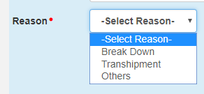
To move goods in multiple vehicles
NOTE: After the submission. Enter the Vehicle Details in “UPDATE PART-B/Vehicle” Option

Slide 41
Json Upload

Slide 42
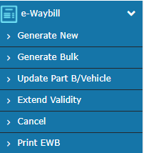
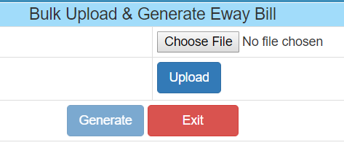
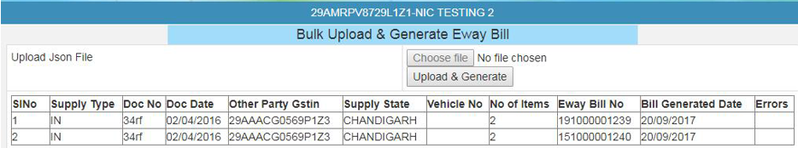
Login and Click Generate Bulk
Upload Json File (Max 1MB)

Slide 43
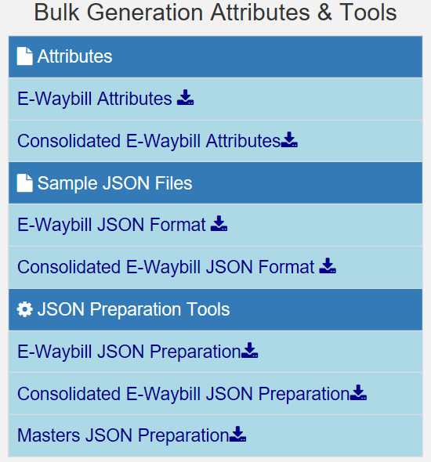
http://164.100.80.111/ewbnat3/Others/FormatDownload.aspx

Slide 44
Mistakes while generating e-Way Bills
‘Total of Tax Values of SGST, CGST, IGST and Cess’ are being entered more than ‘Value/Taxable Value’ of the product.
Abnormal value is being entered for ‘Value / Taxable Value’, that is, more than ₹ 50.00 Crores and so.
GSTIN of the other party is being entered wrongly.
PIN Codes are being entered wrongly.
the HSN codes are being entered wrongly.

Slide 45
E-way bill Access
Consignor / Originator
Generates / Cancel e-way bill
Transporter
Amend/Update of vehicle number
Recipient / Consignee
Accepts
Rejects
Update Vehicle Number

Slide 46
Update by Transporter

Slide 47
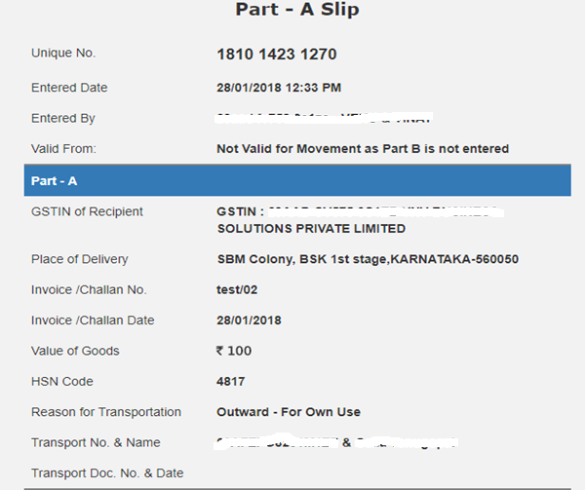
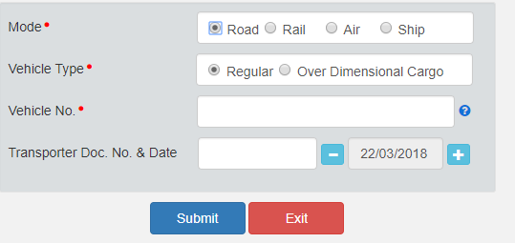
E-way bill without Vehicle Number
Generated by Supplier

Slide 48
Transporter- Updating of Vehicle no.
Login
Update vehicle Number
Select the e-way bill in
“Assigned to Me”
Enter the Vehicle Number and Reason
Submit

Slide 49
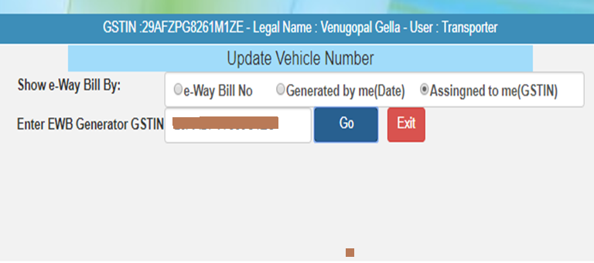
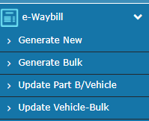
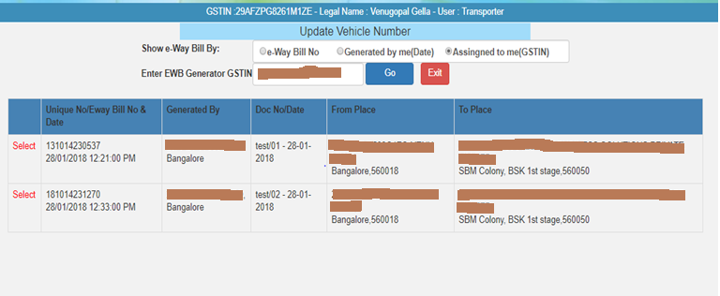
Transporter- Updating of Vehicle Number.

Slide 50
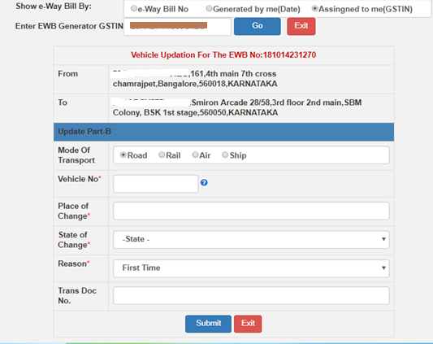
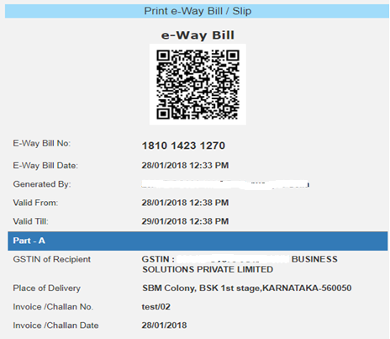
Transporter- Updating of Vehicle no.
Updated eWay Bill
Update All the Changes

Slide 51
Rejection by Recipient

Slide 52
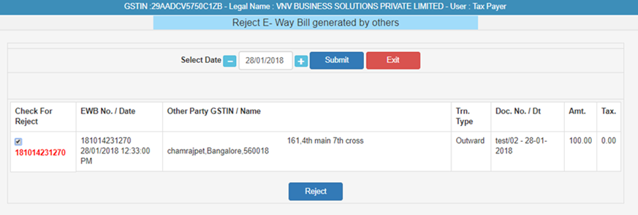
Recipient- Rejection
Login
Reject Menu
Select the e-way Bill
Reject

Slide 53
Cancellation of e-way Bill

Slide 54
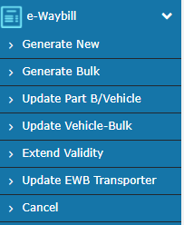
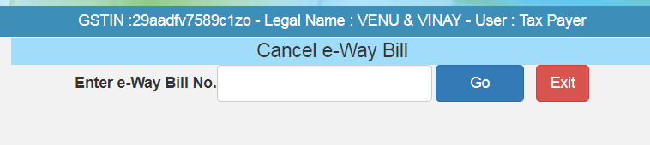
Cancellation by Consignor / Originator

Slide 55
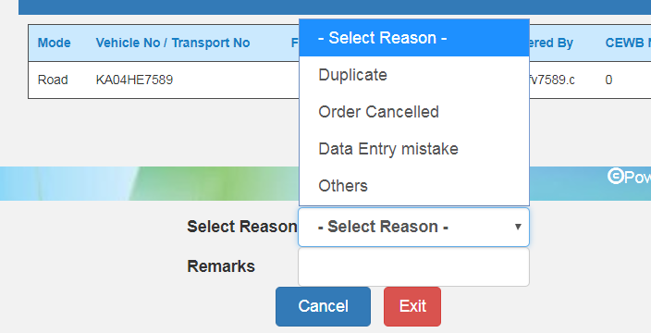
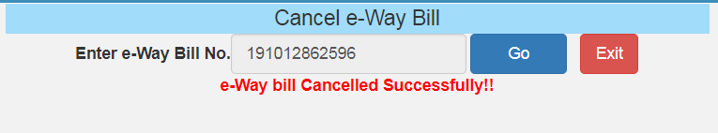
Select reason and click on ‘cancel’

Slide 56
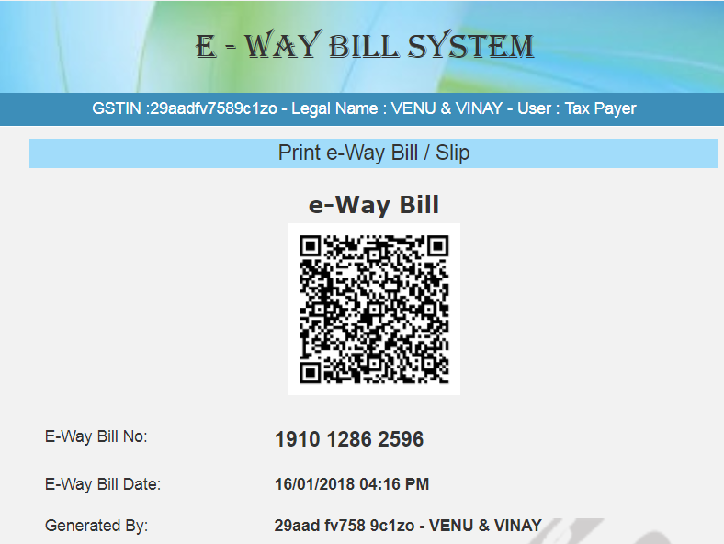
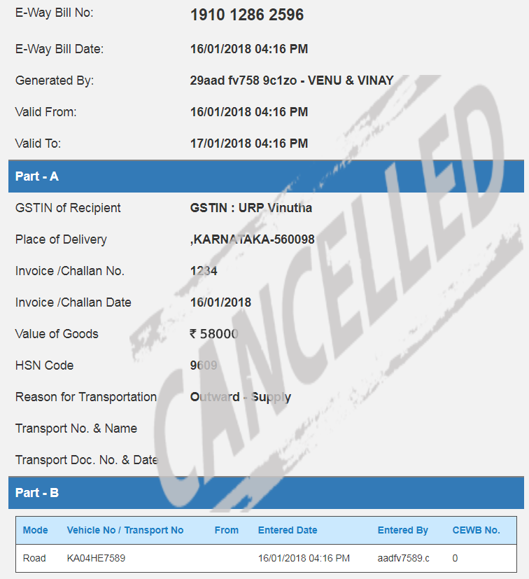
Cancelled

Slide 57
User Management

Slide 58


Create Sub User
Options available only in the Main user menu.
* Sub user only has an option to change password

Slide 59
Freeze Sub User
Once a sub-user is frozen, he/she won’t be able to login E-way bill portal.

Slide 60
Update Sub User
Same like user creation, you can change the options / facilities provided to the users

Slide 61
Change Password
A user shall change his login password under this option.
Once the user clicks on sub option change password under the option user management , the following screen is displayed.

Slide 62
Reports

Slide 63
Reports
My EWB Reports
Outward Supplies
Others EWB Reports
Master Reports
Inward Supplies
CEWB Generated by Me
Cancelled EWBs
Rej. EWBs by Me
Assigned for Transporters
Generated by Others
Rej. EWBs by Others
Ass.to me for Transport
My Masters
EWB Masters
Summary Reports
Date-wise Activities
Notes:
CEWB – Consolidated e-way bill

Slide 64

Outward Supplies Report
EWB.No & Date | Supply Type | Doc. No & Date | Other Party GSTIN. | Transporter Details | TO GSTIN Info | Status & Other Party Rejected Status
231014230537 | Outward | test/01 | 29ABCCV5750C1ZX | 29AABCX0892K1ZK | 30CPDCV5750C1ZB- Almighty BUSINESS SOLUTIONS | Cancelled &

Slide 65


Inward Supplies Report
Consolidated eWAy Bill Generated

Slide 66
Other Reports
Cancelled EWBs
  This will list the e-Way Bills cancelled by the user
Rej. EWBs :
  This will list the e-Way Bills rejected by the other party
Assigned for Transporters
  This will list out all the eway bill transporter wise & their status

Slide 67
My Masters
This generates the list of master entries under different categories

Slide 68

Add Registered Client

Slide 69

Add Un registered Client

Slide 70

Add Products

Slide 71
Utilities
SMS / API / GSP

Slide 72
SMS Registration
https://docs.ewaybillgst.gov.in/Documents/EWB_SMS.pdf
(Ver 1.02 28/03/2018)

Slide 73
e-Way Bill system : SMS Activities
User Options
Users
Update Vehicle Details
Cancel eWay Bill
Transporter
Options
Tax Payer
Generate eWay Bill

Slide 74
Mobile Number Registration

Slide 75


http://164.100.80.180/ewbnat9/Account/SMSReg.aspx

Slide 76
Pre-requisite
opt Registration and ‘for SMS’ option.
The tax payer/transporter can register maximum 2 mobile numbers for the m-Way Bill purpose

Slide 77
Generate the E-WayBill - Taxpayer

Slide 78
Format of SMS request to SMS to :77382 99899
  EWBG
  TranType
  RecGSTIN
  DelPinCode
  InvNo
  InvDate
  TotalValue
  HSNCode
  ApprDist
  Vehicle
(Space should be there between these parameters)

Slide 79
Terms Definition
EWBG - e-Way Bill Generate Key Word – It is fixed for generation
TranType - Transaction Type -Refer to the Code list
RecGSTIN - Recipient’s GSTIN. If it not there, then URP for ‘Unregistered Person’
DelPinCode - PIN Code of Place of Delivery of Goods
InvNo - Invoice or Bill Number of the document of supplier of goods
InvDate - Invoice or Bill Date of the document of supplier of goods
TotalValue - Total Value of goods as per Invoice/Bill document in Rs.
HSNCode - HSN Code of the first Commodity
ApprDist - Approximate distance in KMs between consignor and consignee Vehicle Number in which the goods is being moved
Vehicle - Vehicle Number in which the goods is being moved

Slide 80
Transaction – Sub Type
OSUP – Outward Supply
OEXP – Outward Export,
OJOB – Outward Job Work,
OSCD – Outward SKD/CKD,
ORNK – Outward Recipient Not Known
OFOU – Outward For Own Use,
OEOF – Outward Exhibitions & Fairs
OLNS – Outward Line Sales,
OOTH – Outward Others
ISUP – Inward Supply,
IIMP – Inward Import,
ISCD – Inward SKD/CKD,
IJWR – Inward Job Work Returns,
ISLR – Inward Sales Returns,
IEOF – Inward Exhibitions & Fairs
IOTH – Inward Others

Slide 81
Sample 1 : SMS to 7738299899
EWBG OSUP 29AABCX0892K1ZK 560012 546 10/09/2017 75000.00 1001 234 KA12AB1234
This request is to generate the E-Way Bill for outward Supply of goods, with HSN 1001, to recipient with GSTIN 29AABCX0892K1ZK, carrying Invoice/Bill No 546 dtd: 10/09/2017 of value Rs 75000.00 to deliver at pin code 560012 through vehicle KA12AB1234 and distance of 234 KMs
Response : Eway bill generated successfully. E-WayBill No: 171000000144 and date is 12/09/2017

Slide 82
Sample 2 : SMS to 7738299899
EWBG OEXP URP 560012 A1246 16/09/2017 59000.00 1001 120 MH01XY1233
This request is to generate the E-Way Bill for export of goods, with HSN 1001, to recipient with GSTIN URP (Unregistered Person), carrying Invoice/Bill No A1246 dtd: 16/09/2017 of value Rs 59000.00 to deliver at pin code 560012 through MH01XY1233 distance of 120 KMs
Response : Eway bill generated successfully. E-WayBill No: 181000000234 and date is 16/09/2017

Slide 83
Generate the E-WayBill - Transporter

Slide 84
Format of SMS request to SMS to :77382 99899
  EWBT
  TranType
  SuppGSTIN
  RecGSTIN
  DelPinCode
  InvNo
  InvDate
  TotalValue
  HSNCode
  ApprDist
  Vehicle
(Space should be there between these parameters)

Slide 85
Terms Definition
EWBT - e-Way Bill Generate Key Word – It is fixed for generation
TranType - Transaction Type -Refer to the Code list
SuppGSTIN - Supplier’s GSTIN or “URP” for ‘UnRegistered Person’
RecGSTIN - Recipient’s GSTIN. If it not there, then URP for ‘UnRegistered Person’
DelPinCode - PIN Code of Place of Delivery of Goods
InvNo - Invoice or Bill Number of the document of supplier of goods
InvDate - Invoice or Bill Date of the document of supplier of goods
TotalValue - Total Value of goods as per Invoice/Bill document in Rs.
HSNCode - HSN Code of the first Commodity
ApprDist - Approximate distance in KMs between consignor and consignee Vehicle Number in which the goods is being moved
Vehicle - Vehicle Number in which the goods is being moved

Slide 86
Transaction – Sub Type
OSUP – Outward Supply
OEXP – Outward Export,
OJOB – Outward Job Work,
OSCD – Outward SKD/CKD,
ORNK – Outward Recipient Not Known
OFOU – Outward For Own Use,
OEOF – Outward Exhibitions & Fairs
OLNS – Outward Line Sales,
OOTH – Outward Others
ISUP – Inward Supply,
IIMP – Inward Import,
ISCD – Inward SKD/CKD,
IJWR – Inward Job Work Returns,
ISLR – Inward Sales Returns,
IEOF – Inward Exhibitions & Fairs
IOTH – Inward Others

Slide 87
Sample 1 : SMS to 7738299899
EWBT OSUP 29AXYCX0892K1ZK 29AABCX0892K1ZK 560012 546 10/09/2017 75000.00 1001 234 KA12AB1234
This request is to generate the E-Way Bill for outward Supply of goods, with HSN 1001, to recipient with GSTIN 29AABCX0892K1ZK, carrying Invoice/Bill No 546 dated: 10/09/2017 of value Rs 75000.00 to deliver at pin code 560012 through vehicle KA12AB1234 and distance of 234 KMs
Response : Eway bill generated successfully. E-Way Bill No: 171000002144 and date is 12/09/2017

Slide 88
Sample 2 : SMS to 7738299899
EWBT OEXP 29AXYCX0892K1ZK URP 560012 A1246 16/09/2017 59000.00 1001 120 MH01XY1233
This request is to generate the E-Way Bill for export of goods, with HSN 1001, to recipient with GSTIN URP (Unregistered Person), carrying Invoice/Bill No A1246 dtd: 16/09/2017 of value Rs 59000.00 to deliver at pin code 560012 through MH01XY1233 distance of 120 KMs
Response : Eway bill generated successfully. E-Way Bill No: 1810000120234 and date is 16/09/2017

Slide 89
Cancel the E-WayBill
- Tax Payer or Transporter

Slide 90
Format of SMS request
EWBC EWB_NO
EWBC – E-Way Bill Cancellation Key Word – It is fixed for Cancellation
EWBNo - 12 digits E-Way Bill Number, which has to be cancelled

Slide 91
Sample Example
Particulars | Explanation
Message | EWBC 120023450123
SMS to | 77382 99899
Explanation | This request is to cancel the e-way bill with EWB No 120023450123
Reply Message | e-way bill is cancelled successfully

Slide 92
Update the Vehicle details
- Tax Payer or Transporter

Slide 93
Format of SMS request
EWBV EWB_NO Vehicle ReasCode
EWBV – e-Way Bill Vehicle Updating Key Word – It is fixed for vehicle updation
EWBNo - 12 digits E-Way Bill for which the new vehicle has to be added
Vehicle - New Vehicle number for the movement of goods
ReasCode - Reason Code to indicate why the vehicle number is being added.

Slide 94
Parameter Description with Codes
Parameter | Description | Values/Codes
EWBV | E-Way Bill Vehicle Update | Fixed
EWBNo | E-Way Bill Number | 12 digit numeric value
Vehicle | Vehicle Number which will carry the goods | AB12AB1234 or AB12A1234 or AB121234 or ABC1234 Format
ReasCode | Reason for changing the vehicle | FST – First Vehicle, BRK – Break Down, TRS – Transhipment, OTH – Others

Slide 95
Sample Example
Particulars | Explanation
Message | EWBV 120023450123 KA12BA1234 BRK
SMS to | 77382 99899
Explanation | This request is to update the new vehicle number to the existing E-Way Bill due to break down of previous vehicle
Reply Message | Vehicle details updated successfully and date is 19/12/2017

Slide 96
Best Practices

Slide 97
Update your Clients/Customers and Suppliers
The tax payer has been facilitated on the e-Way Bill system to create onetime master details of his/her customers and suppliers by just entering the GSTIN.
This helps in easily populating the customers and suppliers details by the system, just by typing his/her name at name field while generating the e-Way Bills.
This avoids the mistakes in GSTIN, Place, State and PIN codes of customers or suppliers.

Slide 98
Update Products
The tax payer can create his/her product masters by entering the product details like name, HSN, rate of tax, etc.
So that the product details are auto populated by the system by just typing the 2-3 chars of product name.
This avoids the mistakes in HSN code, rate of tax, UQC, etc.

Slide 99
Manage sub-users carefully
Some of the tax payers may not operate directly themselves always and also they may have multiple additional places from where they need to generate the e-way bills for movement of goods.
To achieve this, the tax payers can create the sub-users to manage the e-way bill system depending upon the requirements.
The different roles can also be assigned to these users.
However, the tax payers should take care while generating these users. Whenever, the employees / operators / managers change, he/she should change the password or freeze the account from miss-utilising the same.

Slide 100
Register for other facilities carefully
SMS based and Android based e-Way Bill
  SMS based E-way Bill has to be generated carefully to avoid mistakes while typing the parameters.
Registration to work as a transporter.
  This registration as transporter facilitates the tax payers to generate the e-Way Bill for other parties as a transporter.

Slide 101
API Interface
Best method for the large tax payers, who generate the large number of e-Way Bills, is API interface.
This is site-to-site integration of the systems for e-way Bill generation. In this method, the tax payer system will directly request the E-way Bill system while generating invoice in his system and get the e-Way Bill number.
This can be printed on the Invoice document and movement of the goods can be started.
This avoids duplicate data entry and eliminates complete data entry mistakes. To use this facility, the tax payers have to request the department for this service

Slide 102

Thank You
For any Clarification, Please Contact
Indirect Taxes Committee of ICAI
Email: idtc@icai.in, Website: www.idtc.icai.org

